Slide 1
Health Insurance Portability and Accountability Act
Heather Hedrick
Privacy Officer
PRIVACY & SECURITY TRAINING
Nemsys IT,
Security Officer
Notes:
Welcome to AAA3’s HIPAA training. We will be discussing privacy and security. Heather Hedrick is the agency’s Privacy Officer and Nemsys is the Security Officer.
HIPAA stands for Health Insurance Portability and Accountability Act established in 1996. Let’s get started….

Slide 2
History of HIPAA
HIPAA = Health Insurance Portability and Accountability Act of 1996
HITECH Act = Health Information Technology for Economic and Clinical Health Act of 2009
Expanded Privacy Rule & Security Standards
Omnibus Rule - 2013
Notes:
HIPAA is a federal law that created national standards to protect the privacy of health information and to set boundaries on the USE and RELEASE of health records, it was established in 1996. As health records were digitized, it lead to the HITECH Act in 2009. In 2013, The Omnibus rule expanded how technology companies protect that information

Slide 3
Who is required to comply with HIPAA laws?
Covered Entities (CE)
Business Associates (BA)
Health plans, health care clearinghouses and health care providers who electronically transmit any health information in connection with transactions for which HHS has adopted standards.
Health Plans, such as:
Health insurance companies, HMOs, Company health plans, Government programs that pay for health care, such as Medicare, Medicaid, and the military and veterans health care programs
Health Care Clearinghouses
Entities that process nonstandard health information they receive from another entity into a standard (i.e.: standard electronic format or data content), or vice versa
Health Care Providers, such as:
Physicians, Clinics, Psychologists, Dentists, Chiropractors, Nursing Homes, Pharmacies
Disclosures of PHI from one CE to another CE for Treatment, Payment, or healthcare Operations (TPO) does not require a Business Associate Agreement (BAA)
A person or entity that supports the healthcare industry and performs functions or activities in support of a Covered Entity.
HIPAA requires a BA who provides services to a CE that includes access to PHI must sign a Business Associate Agreement (BAA)
Third-party administrator that assists a health plan with claims processing
Medical Billing Company
Accountant
Attorney
Email Encryption Provider
File Sharing Vendor
Backup Storage
IT Support Vendor
Shredding Company

Slide 4
Privacy Rule: What does it protect?
Any oral, written or electronic individually-identifiable health information collected or stored by a facility.
Includes information that relates to past, present or future physical or mental condition of an individual.
The rules apply to you when you look at, use or share Protected Health Information (PHI).

Slide 5
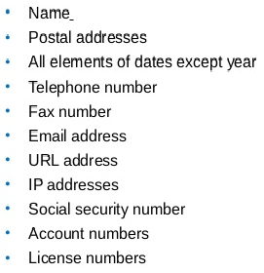
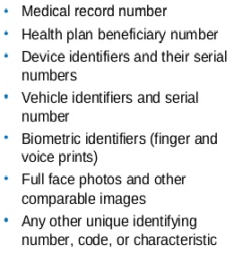
Protected Health Information (PHI)
Consists of:
18 Identifiers
Treatment, Payment or Health Care Operations (TPO)
Notes:
Admission dates, DOB, discharge date, date of death

Slide 6
MINIMUM NECESSARY and NEED TO KNOW
If you don’t Need To Know,
You shouldn’t!
Must make reasonable efforts to use, disclose and request only the MINIMUM NECESSARY PHI needed to accomplish the intended purpose
Notes:
Minimum Necessary is the HEART of HIPAA. Also, remember that people are on a NEED TO KNOW basis; if they don’t need to know, they shouldn’t!

Slide 7
Individuals Privacy Rights
Right to inspect or get copies of their PHI
Right to request an amendment to their PHI
Right to request confidential communications
Right to request an Accounting of Disclosures
Right to request restrictions on the sharing of their PHI
Right to receive our Notice of Privacy Practices
Right to file a Privacy/Security Complaint
Notes:
Right to amend records if they feel they are incorrect. Account of disclosures – people have the right to know where you sent their info – for 6 yrs.

Slide 8
Right to Access
May not impose unreasonable measures on an IND requesting access that serve as barriers to or unreasonably delay the IND from obtaining access.
For example, we can not require an IND:
Who wants a copy mailed to their home to physically come to the office
If an IND requests the information be emailed, you must comply, with the following conditions:
Inform them that you can email it “securely” and the process.
If they do NOT agree to this, then you have to inform them, and they must agree, that there may be security risks to the PHI while the data is in transit. If agree, then you can send the email without encryption.
30 calendar day limit, but CE’s should respond ASAP
Notes:
Realize that when a person is requesting their information, the agency cannot impose unreasonable costs or measures in order to obtain their information.

Slide 9
Right to Access Methods for Payment and Verification
Actual Costs
Flat Rate
Average Costs
Must have documentation of costs.
You cannot overcharge.
Privacy Rule requires a CE to take reasonable steps to verify the identity of the individual making a request for access.
You must document that you verified the identity.
Notes:
While requesting information, you can charge a person BUT you must have documentation explaining the costs and you cannot overcharge. 3 methods of payment are: actual costs, flat rate, and you can take an average of the costs. You also must take reasonable steps to verify the identity of the IND making the request. And, you must document it.

Slide 10
Notice of Privacy Practices
Must provide a notice of the Covered Entity’s privacy practices.
The notice must describe the IND’s rights, including the right to complain to HHS.
Must be posted in lobby and on website.
Must be given on first encounter with individual.
Must be signed every 3 years, per Privacy Rule.
Notes:
A CE has to provide their Notice of Privacy Practices which must describe the IND’s rights, including the right to complain. CEs must post their Privacy Practices, must be given to INDs on first encounter and must be signed every 3 years.

Slide 11
How do we comply with the Privacy Rules?
Require that PHI not be communicated to those who are not authorized to receive the information
Follow “MINIMUM NECESSARY” and “NEED TO KNOW” guidelines
Provide a Notice of Privacy
Review HIPAA policies and procedures
Report complaints or concerns to AAA3’s Privacy Officer (Amy Craig) or the Department of Health and Human Services (HHS)
Notes:
Need to be very mindful of your surroundings; at work and home, but specially when out to lunch or in a public place. Lock all PHI up in a safe place. Keep a “clean desk”
Also, if working in a public place, you cannot leave your LT unattended (bathroom); cannot use public WiFi anywhere and make sure to only discuss PHI with authorized persons

Slide 12
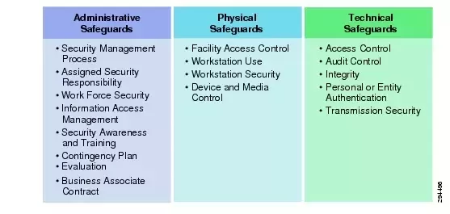
Security Rule: What is it & what does it protect?
The Security Rule requires appropriate administrative, physical and technical safeguards to ensure the confidentiality, integrity and availability of electronic PHI (ePHI).
Notes:
The Sec.Rule requires a CE to apply appropriate administrative, physical and technical safeguards to ensure the confidentiality, integrity & availability of ePHI.
Under the Administrative Safeguards, we assign security responsibilities, control who has access to PHI and in what systems (PIMS vs SAMS vs OHCW), make staff aware of various security situations mainly by email reminders. Partner with the Privacy Officer on Business Associate contracts/agreements.
The Physical Safeguards consist of the various facility access controls in place, such as fobs, alarm and video surveillance systems. Workstation security consists of timed logoffs, making sure staff are conscientious of the position of their monitors (specially when visitors are here or if working at public location such as a library/restaurant; if in public place and have to go to the restroom, you must take your devices with you unless a co-worker is there to monitor it), overall to be aware of your surroundings – when transporting your LT, put it in a safe/secure location, out of public view. Device and Media controls – we have hard drive encryption in place; use shred-it to destroy media.
Under Technical safeguards, Access controls are in place to allow access only to persons that require the data or PHI, we review activity in the various systems the agency uses and take measures to guard against unauthorized access to PHI.

Slide 13
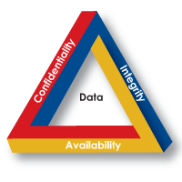
Confidentiality, Integrity and Availability
Confidentiality
Keeping your data private
Integrity
Ensuring that your data is accurate
Availability
Always having access to your data
Notes:
Ways we ensure the confidentiality, integrity and availability of ePHI consist of: keeping the data private, ensuring it’s accurate and having access to the data

Slide 14
Electronic Protected Health Information (ePHI)
What is it?
Locations for ePHI
All PHI past, present or future that is produced, saved, transferred or received in electronic format.
Hard drives
Mobile devices such as cell phones, smartphones, tablets and laptops
Optical media (CDs, DVDs)
USB removable media (flash drives, thumb drives, pen drives, memory sticks, etc)
Biomedical devices such as infusion pumps, ventilators, diagnostic ultrasound machines, etc
Notes:
ePHI is the same as PHI but in electronic form. ePHI can be found on hard drives…

Slide 15
HITECH Act
Health Information Technology for Economic and Clinical Health Act (HITECH)
Was enacted as part of the American Recovery and Reinvestment Act (ARRA) in 2009.
Was created to motivate the implementation of Electronic Health Records (EHR) and supporting technology in the United States.
It strengthens HIPAA by expanding criminal consequences and adding civil penalties for PHI breaches and violations.

Slide 16
What is a Breach?
Examples of breaches:
Not encrypting mobile devices or email that contain PHI
Loss or theft of mobile device that is not encrypted and contains PHI
PHI provided to the wrong requestor
Improper disposal of records containing PHI
Unauthorized viewing of PHI
Confidential communication violations
The unauthorized use or disclosure under the Privacy Rule that compromises the security or privacy of PHI such that the use or disclosure poses a significant risk of financial, reputational, or other harm to the affected individual.
DON’T ACCESS INDIVIDUAL’S RECORDS
WITHOUT A BUSINESS REASON
Notes:
Remember… YOU ARE NOT ALLOWED TO ACCESS A PERSON’S RECORDS WITHOUT A BUSINESS REASON. You could be let go, ordered to pay a fine or go to JAIL.

Slide 17
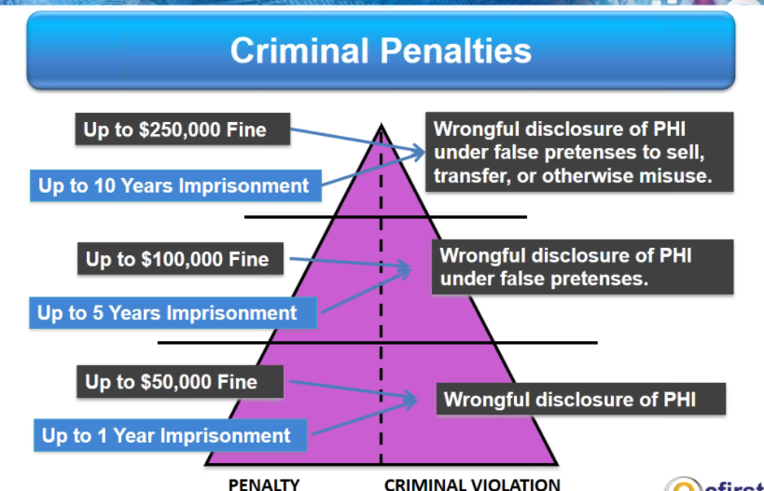
Penalties and Noncompliance
Notes:
No matter the reason, unauthorized disclosure of PHI is considered a violation, making the covered entity subject to penalties and fees.

Slide 18
Breach Notification Rule
Provide notice to individuals affected by the breach
For breaches involving < 500 people:
Notify individuals and maintain a log of security breaches
Breaches can be submitted to HHS at the time of incident or annually
For breaches involving > 500 people:
Notify affected individuals, HHS and the media
Could be put on the “Wall of Shame”
Notes:
The breach notification rule was enacted to provide notice to INDs affected by a breach. For breaches < 500 people…

Slide 19
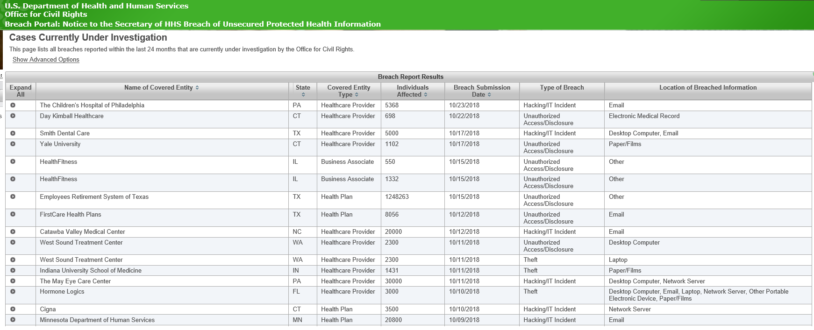
Wall of Shame

Slide 20
Breach Reporting Process
Employee to report any suspected privacy breach or security incident to Supervisor as soon as detected or suspected.
Supervisor to notify the HIPAA Privacy and Security Officers to investigate.
HIPAA Officers to investigate/assess situation.
If a breach has occurred, HIPAA Officers will:
Determine steps necessary to mitigate
Report to the affected organization/person
Work with legal counsel to determine if state and federal laws may be applicable
Recommend possible operational improvements to prevent recurrence
Refer any intentional actions by employee to HR
Post required notifications as quickly as possible, but not to exceed 60 days unless law enforcement agencies request a delay
Notes:
If you suspect a breach of PHI has occurred, report it! Report any suspected breach to your Supervisor, your Supervisor will notify Privacy and Security Officers so they can investigate. They will investigate and determine whether or not a breach has occurred. If one has occurred, we would follow these steps….

Slide 21
Security Awareness
Why is it important?
Notes:
Security Awareness is important because YOU are a vital component in helping us do our job.
No matter how many policies and procedures we have in place, Employees are one of the most important lines of defense against attacks.

Slide 22
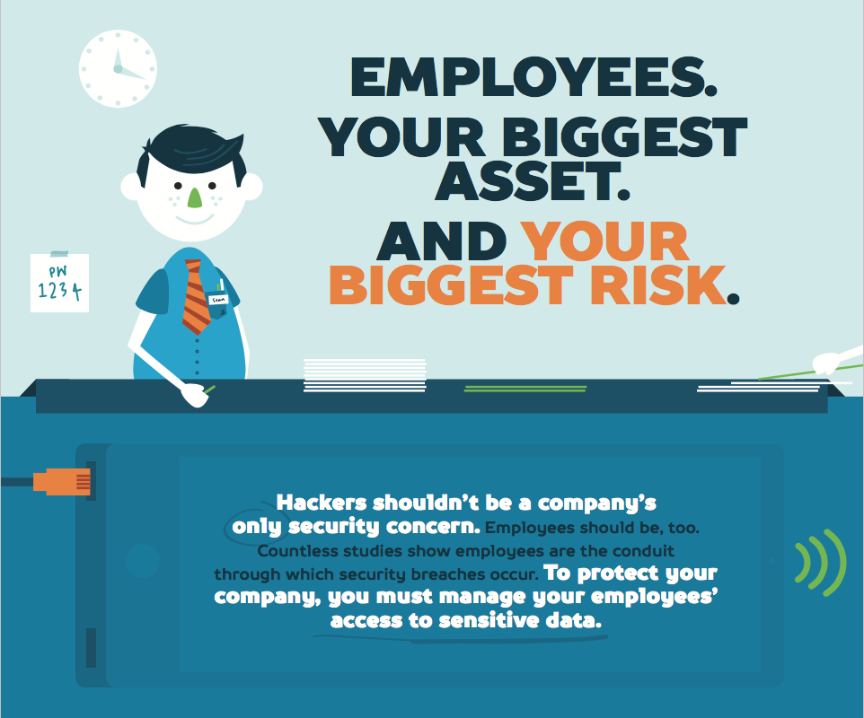
Security Risks
Reduced by a “Culture of Compliance” or following your policies and procedures.
Security is 25% Computer Countermeasures
75% Employee Behavior
Never disable security controls such as antivirus, malware, or firewalls
Do not install screen savers or other programs without prior approval
Personal cell phones should not be charged using agency computer’s USB connection
Notes:
It only takes one click to download malicious software. Security risks are reduced by a “Culture of Compliance” or by following our P&Ps. 75% of compliance is by employee behavior!!! As an employee, you should never disable security controls such as antivirus, malware or firewalls. Do not install unauthorized screen savers or programs and do not charge your personal cell phones while connected to agency equipment as we don’t have control what’s on your phone..

Slide 23
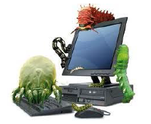
Cyber Attacks & Security Awareness
Hackers use a variety of tools to launch attacks, such as: malware, ransomware, phishing and spear phishing, password attacks, etc.
Infections range from annoying to devastating.
Can spread to other devices by the actions you take, such as opening infected email attachments or clicking on malicious links.
Think twice before clicking
Notes:
Cyber attacks are on the rise. Although we have many preventative measures in place, you must be very careful on what you click on.

Slide 24
Malicious Software (Malware) Examples
Spyware
Adware
Virus
Gathers information without your knowledge and sends it without consent.
Usually obtained by downloading freeware or shareware. Another way is by visiting websites infected with adware.
Goal is to reproduce copies of itself, using any means to spread and are hard to detect without antivirus programs installed.
Notes:
Malware is the term used for malicious software which includes spyware, adware, viruses, worms, etc. All these items have the intent to bring harm to a user, computer system or network.

Slide 25
Malware Examples
Worm
Trojan Horse
Ransomware
Small programs that replicate themselves in a computer and destroy the files and data on it – usually until the drive is empty. Typically show up in email and IM.
Often disguises itself as legitimate software. Once activated, Trojans can enable cyber criminals to spy on you, steal your sensitive data and gain backdoor access to your system.
Restricts access to the computer that it infects and demands a ransom paid to the creator of the malware in order for the restriction to be removed.

Slide 26
Phishing Scams/Attacks
Phishing is a fraudulent attempt to obtain sensitive information such as usernames, passwords and credit card details. It disguises itself as a trustworthy entity, typically in email.
They imitate a known, trusted brand, and try to convince you that your account details or finances are at risk.
Examples:
Amazon Cancellation Scams
Fake PayPal Scam Emails
Facebook Activity Alerts
Disputed Payment Emails
Google and Gmail Alert Scams
What to look for:
The message contains mismatched URL/link (hover over them and it won’t be the same as the link)
Message asking for personal information
The offer seems too good to be true
You didn’t initiate the action
You are asked to send money to cover expenses
The message makes unrealistic threats
Appears to be from a government agency
Something just doesn’t look right
Spelling mistakes, misuse of punctuation
Notes:
One thing that all the malware have in common is that they can all be the result of a phishing scam or attack.

Slide 27
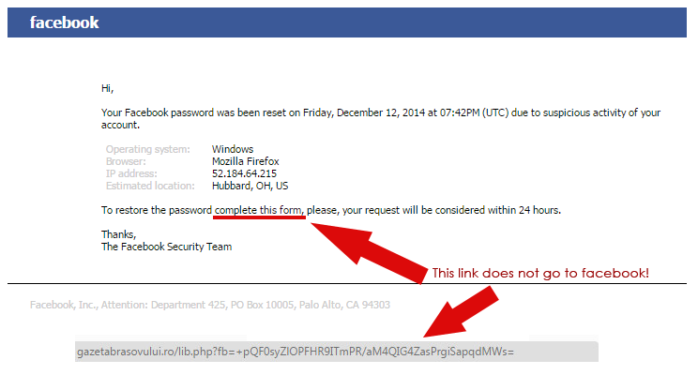
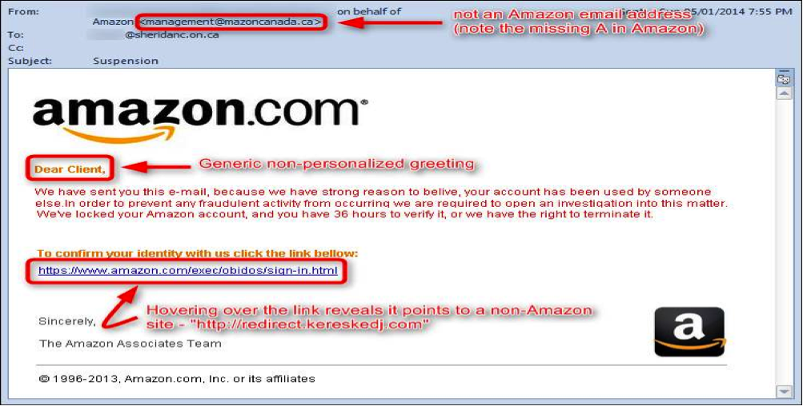
What to look for…

Slide 28
Malware Best Practices
Do NOT open email, email attachments or links if…
Looks suspicious
Typically target financial areas, shipments or any emails you weren’t expecting
You hover over a link and the link isn’t correct (misspelling, wrong website)
It’s something that you were thinking “Why did I get this?”
For example, email stating your order has shipped but you didn’t order anything
It isn’t business-related
Only use the web and email for Work-related purposes
Don’t download or install any unauthorized software/documents
When in Doubt contact IT to verify.
Notes:
One sign that you could have a possible infection is if you click on a link or open an attachment but it didn’t do anything – didn’t open or take you to the website, report it to IT as you could be infected

Slide 29
Work Space Reminders
All forms containing PHI should be placed faced down.
When you leave your workstation, press “Windows” + L key to lock it.
Do NOT throw away paper with PHI (including Post-It notes). Must be put in shred-it bins or cross-shredded.
Clear your work area of PHI before leaving for a break, lunch, or the day.
Never leave your web browser open when it is not in use.
Be conscientious of position of monitor(s) and unauthorized persons.
Never leave mobile devices unattended in unsecured areas.
Maintain Strong Passwords!
Notes:
This applies when you are working in the office or remotely

Slide 30
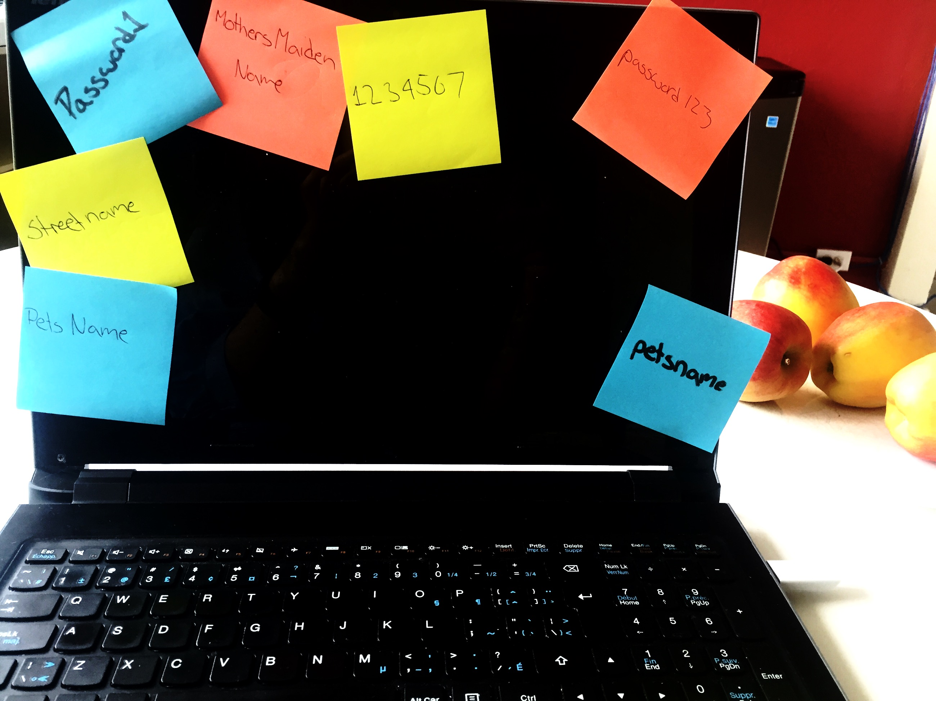
AAA3 Windows/Email Password Policy and Reminders
Must be 10 characters long
Must contain the following:
Uppercase letter
Lowercase letter
Special symbol
Number
Can’t be one of the last 6 passwords that you’ve used
Use different passwords for work and home
Never divulge passwords.
Don’t leave your password in an unsecured location
Change your password if you feel it has been compromised
Notes:
Password length is only going to get longer, so start thinking of “phrases” instead of words. Avoid using family names, pets, birthdays, favorite sports teams, etc.

Slide 31
Emails containing PHI
All emails you send containing PHI must be encrypted. To do so, add one of the following words to the Subject line:
Secure (typically use)
Encrypt
Confidential
Do not put PHI in the subject line
If you receive an unencrypted email that contains PHI, you must add “secure, encrypt or confidential” in the subject line before replying back to it. Also, need to delete any PHI if on Subject line.

Slide 32
Protecting Patient Privacy
Everyone’s Responsibility
Protect PHI
Properly dispose of all PHI.
Do not discuss individuals information in public areas or with those not involved in the care of that person.
Only use, request or send the MINIMUM information NECESSARY.
Only carry the PHI you need for the persons that you are seeing (this includes both paper and electronic records).
Do not leave an individuals records or mobile devices exposed in your vehicle.
Store all PHI in a secure location when not working on it.
When in an individuals home or public area, make sure PHI is not seen by unauthorized persons.

Slide 33
Patient Privacy Around the Office
Be mindful of visitors and PHI
Visitors should be escorted by an employee
If you find that someone is not being escorted, ask who they are visiting and escort them to the proper location
Visitors should not be given access to systems containing PHI unless proper authorization is granted
Lock your computer whenever you are away from your work area
Lower your voice when discussing PHI, if possible
Never give your badge to anyone else

Slide 34
Patient Privacy, cont’d
COPIES:
Limit the number of copies containing PHI to the minimum necessary
Shred all papers containing PHI when no longer needed
FAXING:
Use a cover sheet that contains the agency’s confidentiality statement
Address to the party authorized to receive the PHI
ORAL Communications:
Do not discuss PHI in “public” locations where unauthorized persons can hear
Verify the identity of individuals on the phone
Keep voicemail messages brief
Calls should only be made to the phone number(s) that the IND/guardian has authorized
If unauthorized persons can hear, don’t use speakerphone
MAIL
If sending PHI through the mail, you must use certified mail or a similar service to ensure that the PHI makes it to its destination. This needs to be recorded and could be required if audited.
Notes:
Mailing – and Right of Disclosures

Slide 35
All Agency-Related Equipment and Internet Services
For business purposes only!
Includes Agency WiFi & Email
Notes:
Agency Equipment is for work purposes only. You are not permitted to conduct any personal Business or media access using your Agency provided equipment. You are not permitted to use a open Public Wifi. Your Agency has provided you with the ability to use a hotspot or direct LTE access from your equipment.
At all times you should be attached via VPN as well so you have the most data protection as well.

Slide 36
HIPAA Privacy & Security Policies and Procedures
Contact and Document Information
Heather Hedrick,
Privacy Officer
hhedrick@psa3.org
419-222-7723
Nemsys IT
Security Officer
support@nemsys.com
419-243-3603
PSA3 Shared – All Staff\AAA3 Policies & Procedures\8 HIPAA

